Slide 1
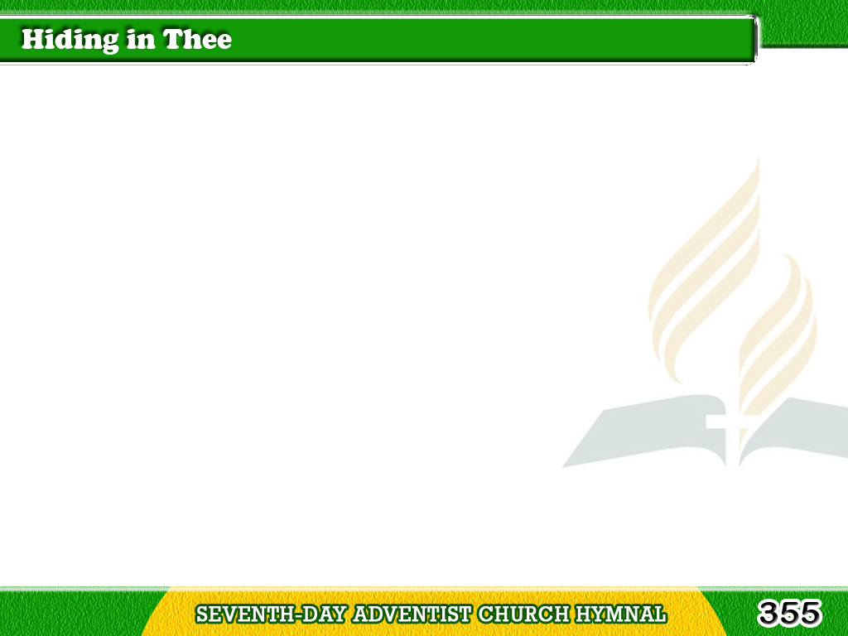
1/3
O safe to the Rock
that is higher than I,
My soul in its conflicts
and sorrows would fly;
Tagalog
Version

Slide 2
1/3
So sinful, so weary, Thine,
Thine would I be;
Thou blest “Rock of Ages,”
I’m hiding in Thee.
Tagalog
Version

Slide 3
1/3
Chorus
Hiding in Thee,
Hiding in Thee,
Thou blest “Rock of Ages,”
I’m hiding in Thee.
Tagalog
Version

Slide 4
2/3
In the calm of the noontide,
in sorrow’s lone hour,
In times when temptation casts
o’er me its power;
Tagalog
Version

Slide 5
2/3
I’m hiding in Thee,
In the tempests of life,
on its wide, heaving sea,
Thou blest “Rock of Ages,”
Tagalog
Version

Slide 6
2/3
Chorus
Hiding in Thee,
Hiding in Thee,
Thou blest “Rock of Ages,”
I’m hiding in Thee.
Tagalog
Version

Slide 7
3/3
How oft in the conflict,
when pressed by the foe,
I have fled to my Refuge
and breathed out my woe;
Tagalog
Version

Slide 8
3/3
How often, when trials
like sea billows roll,
Have I hidden in Thee,
O Thou Rock of my soul.
Tagalog
Version

Slide 9
3/3
Chorus
Hiding in Thee,
Hiding in Thee,
Thou blest “Rock of Ages,”
I’m hiding in Thee.
Tagalog
Version

